Slide 1
Category review: Chips
June 2020
Retail Analytics
Brand note: If client logo is not required, use alternate title page layout right click slide thumbnail > Layout > Title

Slide 2
Notes:
To view Privacy video explaining how important data privacy is to Quantium, please click here: https://www.youtube.com/watch?v=Zq1QDAkoRzU
or here Q:\Company Reference\Brand & Design\Brand videos\Q Privacy.mp4
At Quantium, we believe that data is the behavioural footprint of humanity and that it has to be treated with the utmost care and responsibility.
Histories, attitudes, indeed lives are stored within it in ways that aren’t always apparent – and that’s what makes its potential so powerful.
To work with it responsibly, sensitively, we set ourselves the highest data privacy protection and governance standards.
We have spent 17 years perfecting privacy-by-design and secure-by-design principles. Central to this is not holding any personally identifiable information about people –
we neither receive it, and put the necessary protections in place to be unable to decipher it.
Every aspect of handling data is safeguarded: from its de-identification, to its encryption – data security is paramount and of the highest grade.
We pride ourselves on gaining the trust of iconic organisations around the world through years of securely working with their data,
and in turn the trust that builds with their stakeholders.

Slide 3
Executive summary
01
Task 1
The data had a lot of outliers and had to be normalised
Data was summarised and all the summaries will b mentioned in the next slide
Data formats were mostly in the form of a floating variable and integer values.
02
Task 2
Total_sales revenue came out to be around 1933115 dollars
Total customers currently using that particular store are 241584 approximately
There are about 0.91 transactions that are happening per customer.

Slide 4
01
Task 1 Findings and Analysis

Slide 5

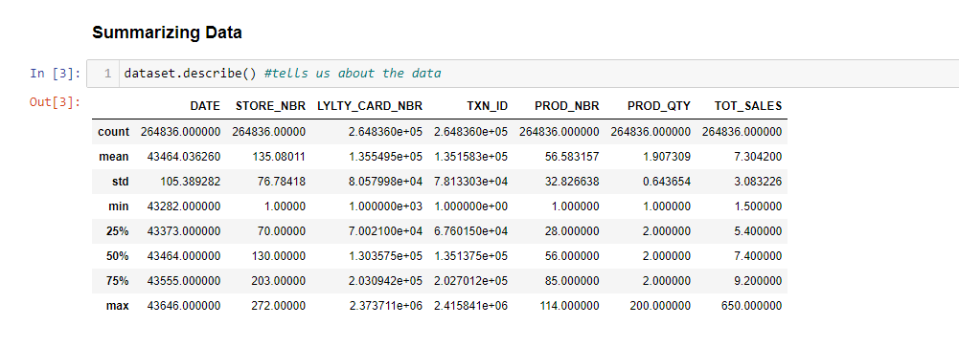
The type of chip plays a major role in the way that the consumer wants to consume it. The better the taste more the marketing of those chips will be done and more successful will it become.

Slide 6

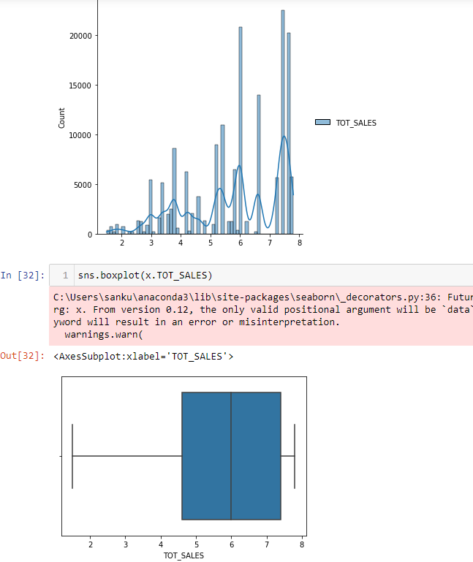
The taste of the chip is the primary concern. Nowadays baked chips are enthralling the market more because of the increased awareness for taking care of their health. That’s why our top performing chips are the ones that are either doritors or baked ones. They are definitely growing but are best ones are still the chips who have completely dominated the market over the past many years

Slide 7
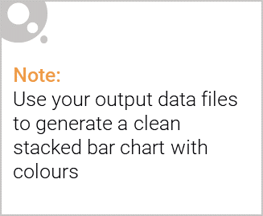
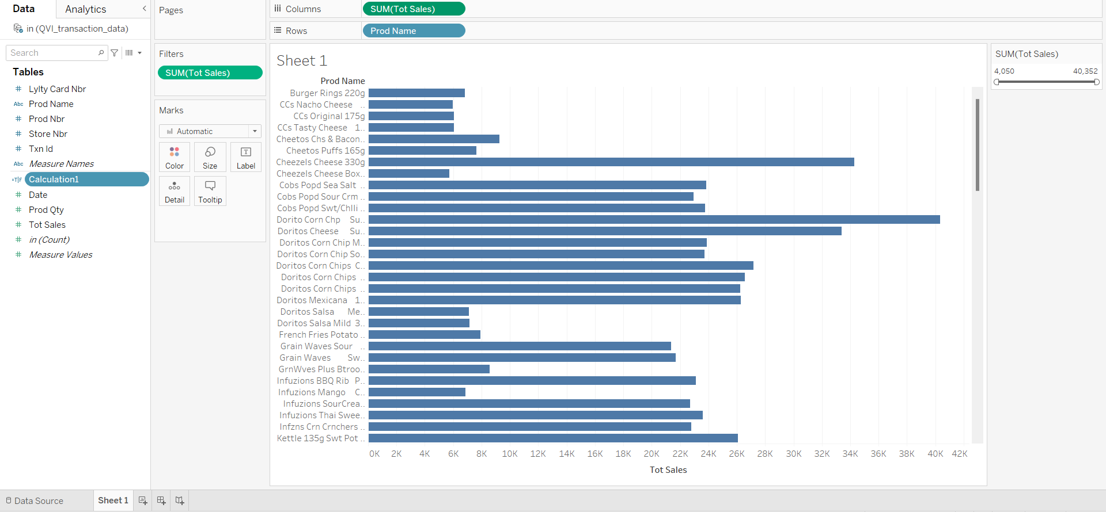
Editable (delete this)
A Visual Analysis below.

Slide 8
02
Trial store performance

Slide 9
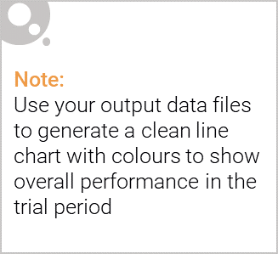
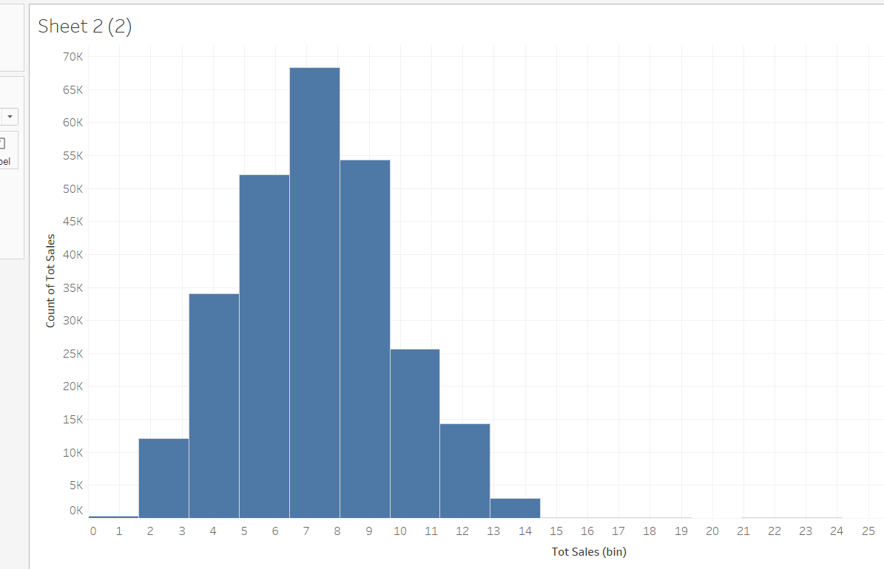
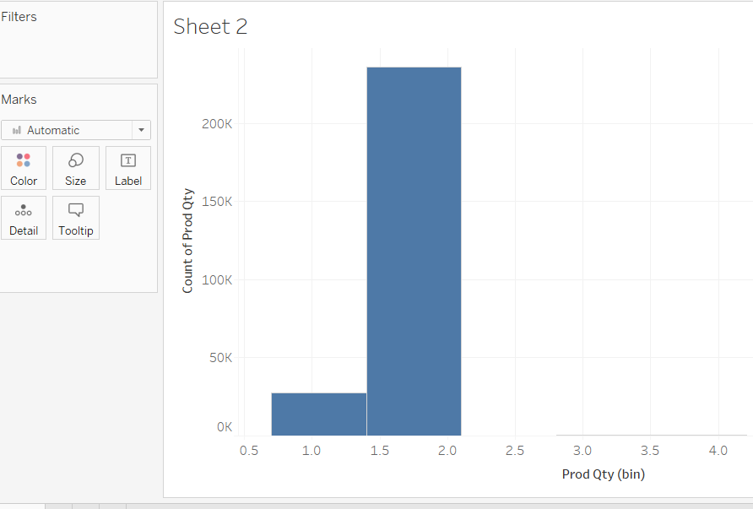
We’ve found control stores 233, 155, 237 for trial stores 77, 86 and 88 respectively. The results for trial stores 77 and 88 during the trial period show a significant difference in at least two of the three trial months but this is not the case for trial store 86. We can check with the client if the implementation of the trial was different in trial store 86 but overall, the trial shows a significant increase in sales. Now that we have finished our analysis, we can prepare our presentation to the Category Manager.

Slide 10

